Slide 1

Team Details
Team Name: Pixel Perfect
Team Leader Name: Ganesh V
Problem Title: ONLINE PARKING SLOT RESERVATION SYSTEM USING ML, RFID AND AR

Slide 2


Brief Problem Statement
In metropolitan areas, most vehicle drivers have the daily concern of finding a vacant parking space especially during rush hours.
So, many parking management systems have been deployed in order to reduce such traffic congestion and improve the convenience of vehicle drivers.

Slide 3
Short Solution
Currently, most of the existing car parking system are manually managed and a little inefficient.
In Urban areas, where number of vehicles is higher as compared to the availability of parking spaces, a lot of time being wasted in searching for parking locations.
Hence online booking parking system is a proposed method that users can reserve their parking places using web.

Slide 4

Brief Solution
Automated Entry and Exit with RFID Technology:
Implement Fastag RFID chits on vehicles for automated entry and exit, enabling seamless vehicle identification and access control to reduce wait times.
Real-Time Slot Monitoring with Machine Learning:
Deploy cameras and use a Convolutional Neural Network (CNN) algorithm to automatically detect and update the status of parking slots in real-time on a web application.
AR Map Integration for Virtual Navigation:
Integrate augmented reality (AR) maps into the web application to provide users with a virtual view of the parking facility and assist in navigation to and within the parking area.

Slide 5

List of features offered by the solution
Urban Parking Management: Implement RFID, camera monitoring, and AR navigation to optimize urban parking spaces.
Traffic Reduction: Streamline parking processes to minimize search times and reduce traffic congestion.
Partnership Opportunities: Collaborate with MNCs and malls to enhance parking management and generate shared revenue.
Global Expansion: Leverage MNC networks for easy entry into international markets facing parking challenges.
Enhanced User Experience: Provide real-time parking updates and AR navigation for improved user convenience.
Sustainability Initiatives: Maximize existing parking space usage and reduce vehicle emissions through efficient parking solutions.

Slide 6
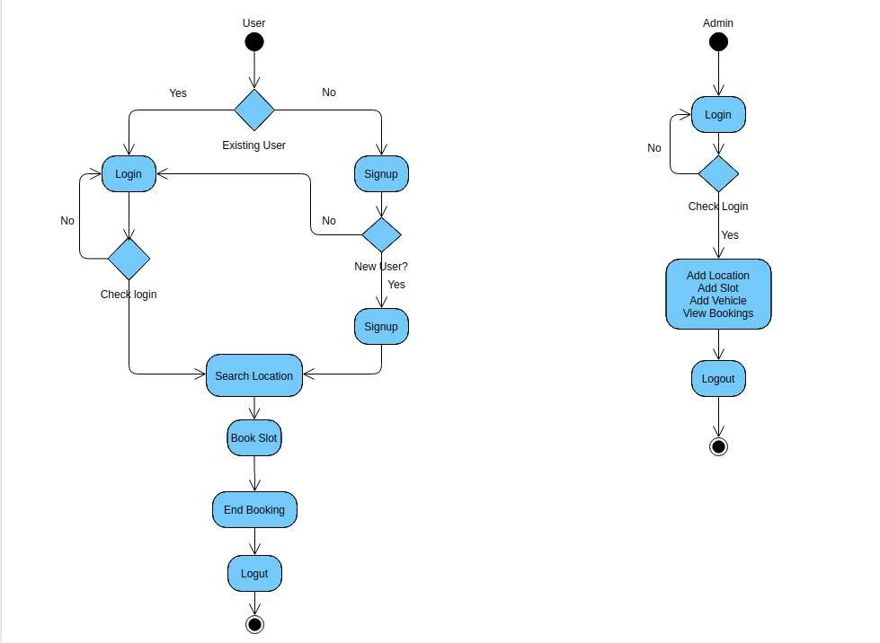
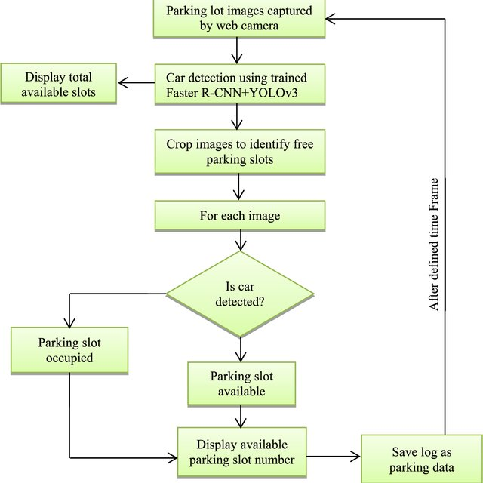
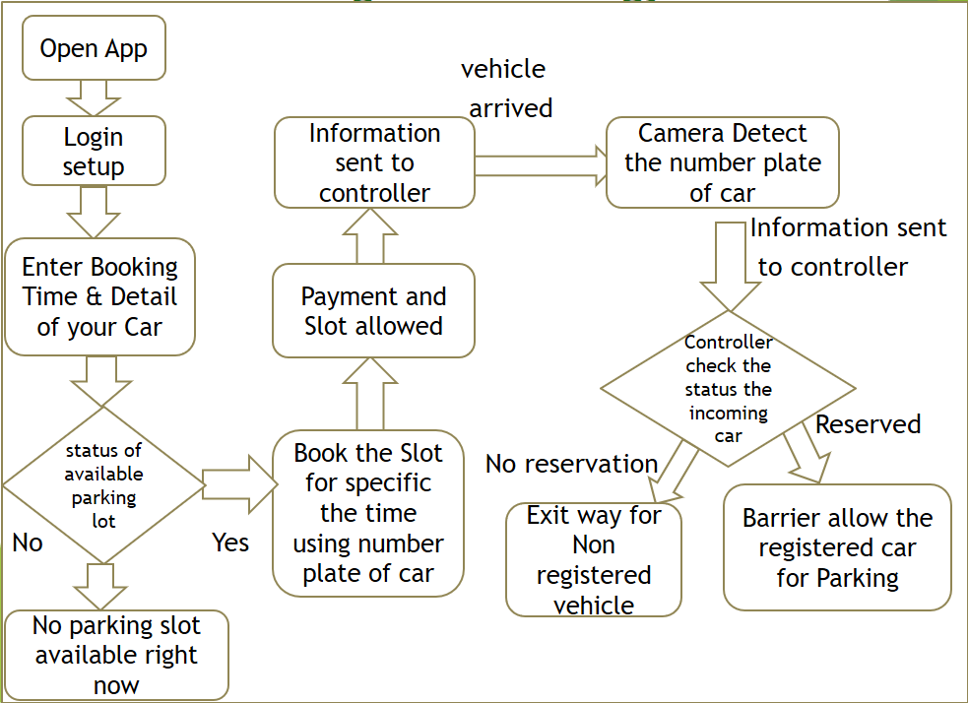
Process flow diagram or Use-case diagram
Flow Diagram Of Website
Availability Of Space Updating in Website Using ML
Entire Flow Of Project

Slide 7
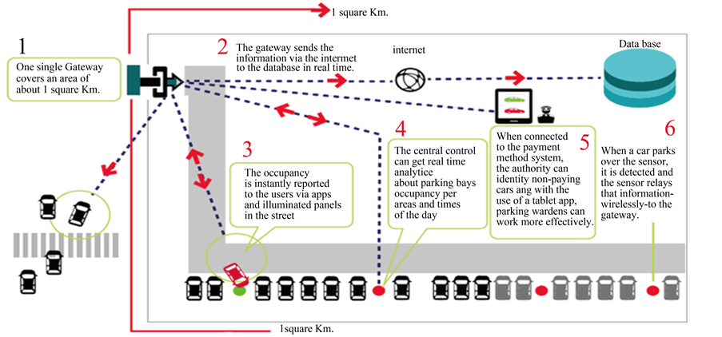
Architecture diagram of the proposed solution

Slide 8


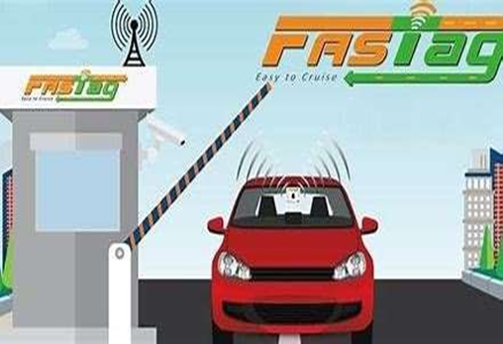
Technologies to be used in the solution
RFID Technology:
Fastag RFID tags for automated vehicle identification and access control.
Camera and Machine Learning:
High-resolution cameras paired with CNN algorithms to monitor parking slot availability.
Web Application:
Frontend: React for a responsive and dynamic user interface.
Backend: Node.js for handling authentication, data processing, and hardware integration.
Augmented Reality (AR):
ARCore and ARKit for providing virtual navigation maps and overlays.
Cloud Infrastructure:
AWS or Google Cloud for storage, computing services, and database management.
Security Measures:
SSL/TLS encryption for secure data transmission.
OAuth 2.0 for secure user authentication and authorization.
DevOps and Deployment:
CI/CD pipelines with Jenkins for automated testing and deployment.
Docker for containerization and Kubernetes for managing containerized applications and ensuring scalability.

Slide 9


Estimated implementation cost
Initial Development Costs:
App and Website Development: ₹5,00,000 to ₹15,00,000
Backend Infrastructure: ₹2,00,000 to ₹5,00,000
Design and User Interface: ₹1,00,000 to ₹3,00,000
Operational Costs:
Server and Hosting: ₹50,000 to ₹2,00,000 annually
Maintenance and Updates: ₹1,00,000 to ₹3,00,000 annually
Customer Support: ₹2,00,000 to ₹5,00,000 annually
Marketing and Promotion:
Digital Marketing: ₹2,00,000 to ₹10,00,000
Offline Marketing: ₹1,00,000 to ₹5,00,000
Legal and Compliance:
Licensing and Permits: ₹50,000 to ₹2,00,000
Legal Fees: ₹1,00,000 to ₹3,00,000
Miscellaneous Costs:
Office Space and Utilities: ₹2,00,000 to ₹5,00,000 annually
Miscellaneous Expenses: ₹1,00,000 to ₹3,00,000

Slide 10
Estimated price cost for User
Project offers a variety of parking services, including hourly, daily, weekly, and monthly plans. The cost can vary depending on the location and type of service you choose. Here are some general price estimates:
Hourly Parking: Typically ranges from ₹50 to ₹100.
Daily Parking: Usually around ₹200 to ₹500.
Weekly Parking: Approximately ₹1000 to ₹2000.
Monthly Parking: Can range from ₹3000 to ₹5000.

Slide 11
Estimated price cost for User
Project offers a variety of parking services, including hourly, daily, weekly, and monthly plans. The cost can vary depending on the location and type of service you choose. Here are some general price estimates:
Hourly Parking: Typically ranges from ₹50 to ₹100.
Daily Parking: Usually around ₹200 to ₹500.
Weekly Parking: Approximately ₹1000 to ₹2000.
Monthly Parking: Can range from ₹3000 to ₹5000.

Slide 12


Master Plan
Phase 1: Research and Development (Months 1-6)
Phase 3: Full-Scale Launch (Year 2)
Feasibility Study: Research market demand and potential partners.
Expansion: Deploy across multiple Bangalore locations.
Technology Development: Create and test prototype parking solutions.
Marketing: Launch targeted marketing campaigns.
Prototype Testing: Gather feedback on prototype performance.
Support Setup: Establish customer support infrastructure.
Phase 2: Pilot Program (Months 7-12)
Phase 4: Expansion and Scaling (Year 3-4)
Site Selection: Choose pilot locations in Bangalore.
National Rollout: Expand to major Indian cities.
Partnerships: Secure agreements with MNCs, malls, and local businesses.
International Growth: Explore global market opportunities.
Refinement: Continuously improve system based on feedback.
Testing: Implement and evaluate system functionality.
Phase 5: Long-Term Growth (Year 5 and Beyond)
Diversification: Offer data analytics and sustainability features.
Leadership: Aim to become a global leader in smart parking solutions.
Innovation: Focus on technological advancements and strategic partnerships.

Slide 13


